Slide 1


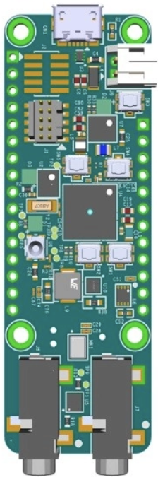
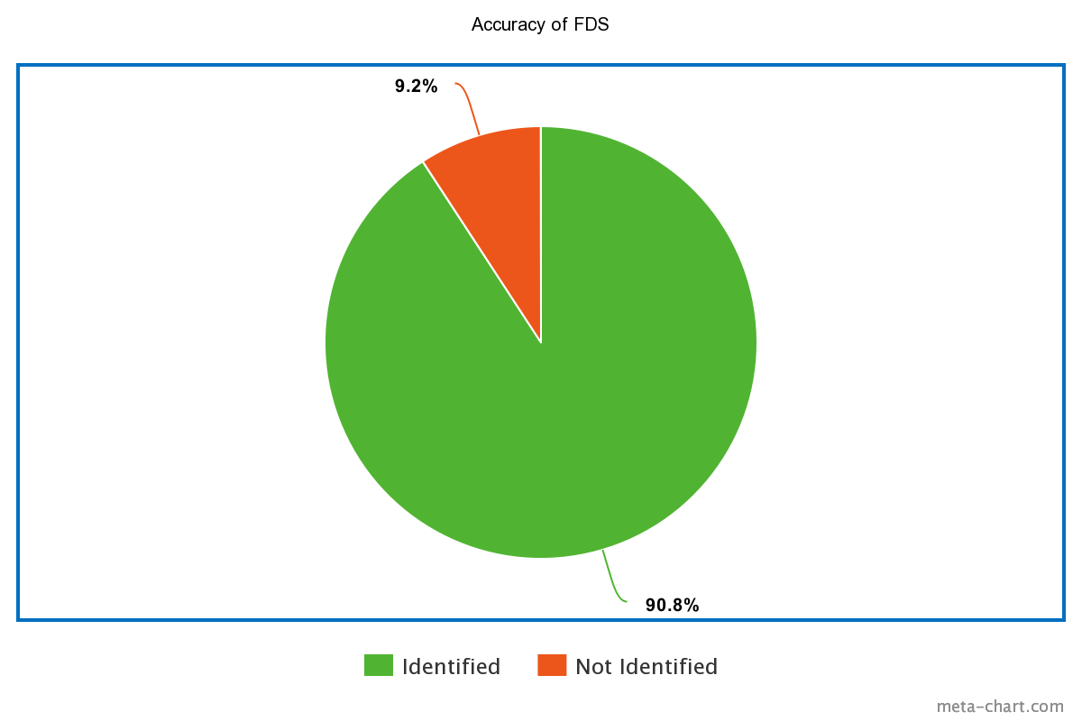
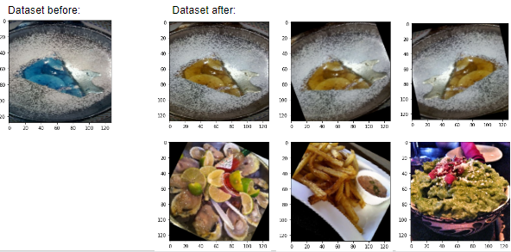
Food Detection System - UTDesign II
(CE) Omar Resendiz, (CE) Mariela Ramirez, (CE) Karthik Gopan, (CE) Jordan Rider, (EE) Chujie Guan
Objectives:
Enumerate key features:
We managed to create the neural network by using modified code that was provided to us about MAXIM
We trained the NN on 10 foods/items that would be common to be microwaved
Uploaded our code to the board and used the onboard camera to successfully identify several foods at least 90% of the time
Created image augmentation code that allows us to use more images
Accurately detect and identify food types and at least 10 food classes
Operate on the Ultra Low Power PCB
Design an augmented dataset for a deep learning model
Report model performance metrics to computer terminal
Synthesize the data into a form the MAX78000 will be able to load
Create our own machine learning neural network using MAXIM code as a base.
Performance Metrics:
How many foods could it identify on the first try from a clear angle (as if it was inside a microwave?)
Key Milestones:
Created basic ai8x training neural network using augmented dataset
Created custom class to be used with pytorch.datasets
Performed convolutional neural network programs on Eclipse IDE
Achieved an accuracy of 90% when identifying food items
Artificially expanded dataset by 3~4 times with our custom image augmentor

